Slide 1
Graph Algorithm

Slide 2
DIJKSTRA’S ALGORITHM
Consider the single-source shortest-paths problem:
For a given vertex called the source in a weighted connected graph, find shortest paths to all its other vertices.
Single-source shortest-paths problem asks for paths, each leading from the source to a different vertex in the graph, though some paths may, of course, have edges in common.

Slide 3
DIJKSTRA’S ALGORITHM
Practical applications of the shortest-paths problem:
Transportation planning
Packet routing in communication
Networks, including the Internet
Social networks
Speech recognition
Document formatting
Robotics
Airline crew scheduling
Pathfinding in video games
Finding best solutions in puzzles

Slide 4
DIJKSTRA’S ALGORITHM
Best-known algorithm for the single-source shortest-paths problem, called Dijkstra’s algorithm.
This algorithm is applicable:
To undirected and directed graphs
With nonnegative weights only
Works only for connected graphs
Dijkstra’s algorithm finds the shortest paths to a graph’s vertices in order of their distance from a given source.

Slide 5
DIJKSTRA’S ALGORITHM
First, it finds the shortest path from the source to a vertex nearest to it.
Then to a second nearest, and so on
Main logic of algorithm is based on following formula:
dist(j) = min(dist(j), dist(i)+cost(i,j))
Formula can also be expressed as:
if(dist ( i ) + cost ( i ,j ) < dist( j ) )
dist ( j ) = dist ( i ) + cost ( i ,j )
A
2
B
2
C
Approach of Dijkstra Algorithm:
Select vertex with shortest path and then update the shortest path to other vertices if possible.

Slide 6
DIJKSTRA’S ALGORITHM
To find a shortest path from a given node s to other nodes in a network (one-to-all shortest path problem)
General description of algorithm:
Dijkstra’s algorithm starts by assigning some initial values for the distances from node s and to every other node in the network.
It operates in steps, where at each step the algorithm improves the distance values.
At each step, the shortest distance from node s to another node is determined

Slide 7
DIJKSTRA’S ALGORITHM
Mark your selected initial node with a current distance of 0 and the rest with infinity.
Set the distance of adjacent vertex as the cost of the edge to that vertex
Set out to visit a new node, choose the node with the smallest known distance/cost to visit first.
Once moved to the node visit all its adjacent nodes.
For each adjacent node, calculate the distance/cost for the nodes using formula.
If distance/cost to a node is less than a known distance, update the shortest distance that we have on file for that vertex.

Slide 8
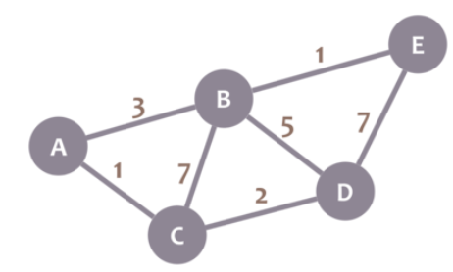
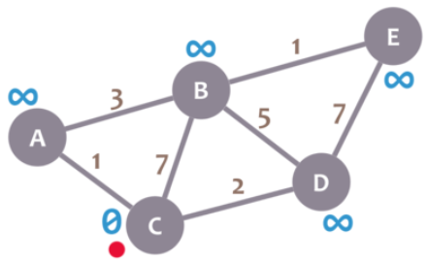
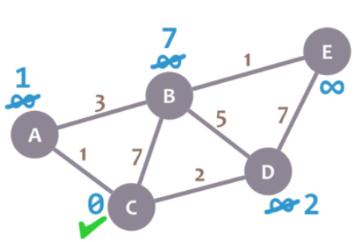
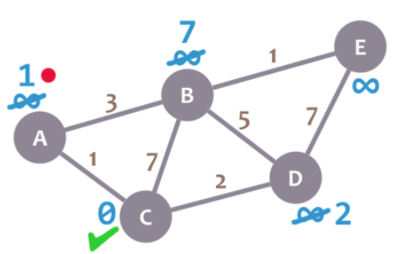
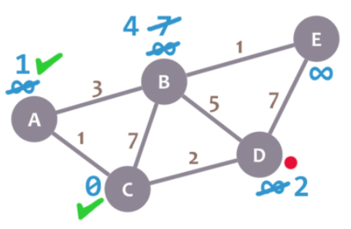
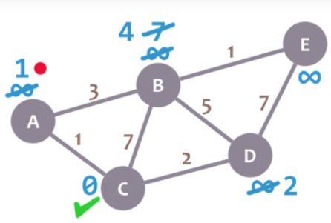
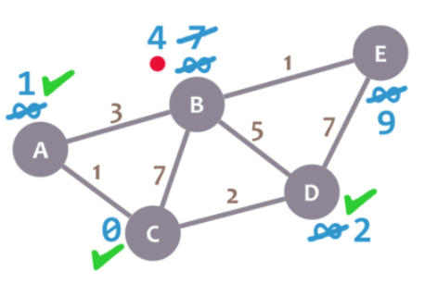
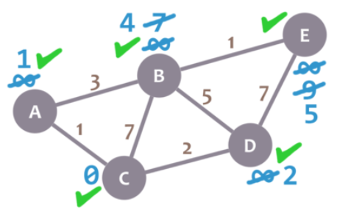
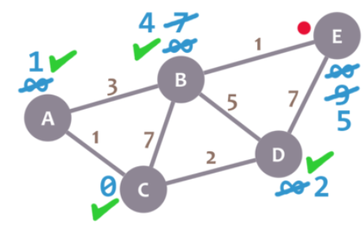
DIJKSTRA’S ALGORITHM
if(dist ( i ) + cost ( i ,j ) < dist( j ) )
dist ( j ) = dist ( i ) + cost ( i ,j )

Slide 9
Algorithm Formal Description
The algorithm characterizes each node by its state
The state of a node consists of two features:
distance value and status label
Distance value of a node is a scalar representing an estimate of the its distance from node s.
Status label is an attribute specifying whether the distance value of a node is equal to the shortest distance to node s or not.
The status label of a node is Permanent if its distance value is equal to the shortest distance from node s
Otherwise, the status label of a node is Temporary
The algorithm maintains and step-by-step updates the states of the nodes
At each step one node is designated as current

Slide 10
Algorithm Steps
Step 1. Initialization
Assign the zero distance value to node s, and label it as Permanent. [The state of node s is (0, p)]
Assign to every node a distance value of ∞ and label them as Temporary. [The state of every other node is (∞, t)]
Designate the node s as the current node

Slide 11
Algorithm Steps
Step 2. Distance Value Update and Current Node Designation Update
Let i be the index of the current node.
Find the set J of nodes with temporary labels that can be reached from the current node i by a link (i, j). Update the distance values of these nodes.
Determine a node j that has the smallest distance value dj among all nodes j.
Change the label of node j to permanent and designate this node as the current node.

Slide 12
Algorithm Steps
Step 3. Termination Criterion
If all nodes that can be reached from node s have been permanently labeled, then stop - we are done.
If we cannot reach any temporary labeled node from the current node, then all the temporary labels become permanent.
Otherwise, go to Step 2.

Slide 13
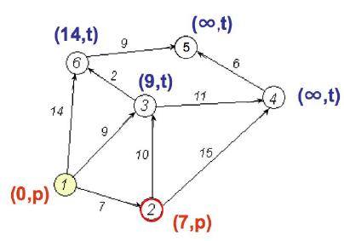
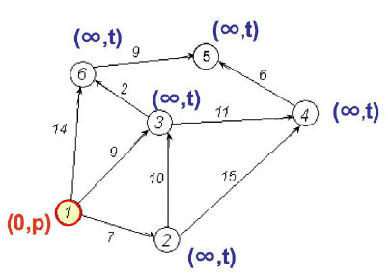
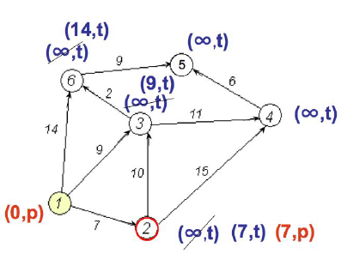
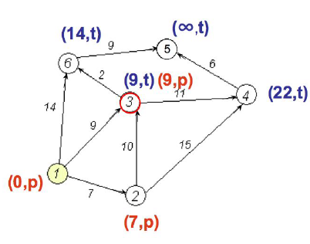
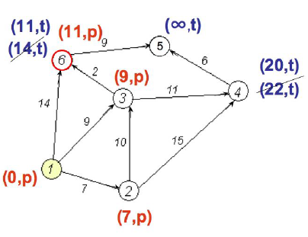
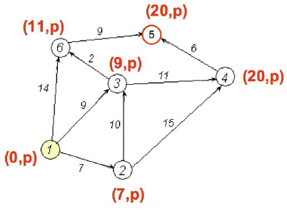
dist(j) = min( dist(j), dist(i)+cost(i, j) )

Slide 14
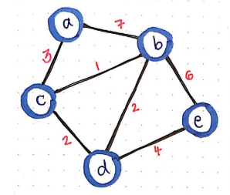
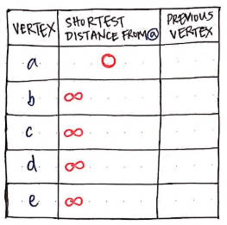
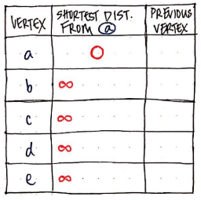
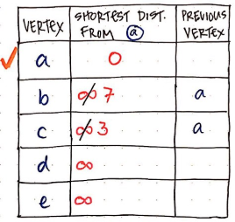
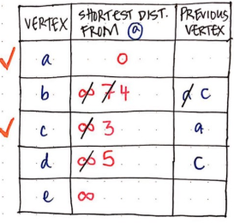
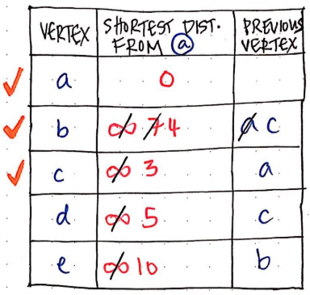
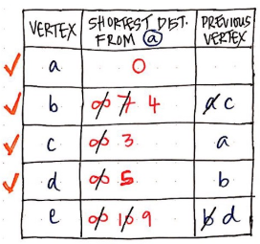
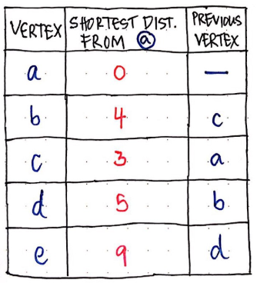
Create a table to keep track of the shortest known distance to every vertex in our graph.
Initially, the “shortest path from node a" is going to be infinity
Since we start at node a, so, the shortest distance from node a to node a is actually just 0
Using table we will also keep track of the previous vertex that we came from
dist(j) = min( dist(j), dist(i)+cost(i, j) )

Slide 15
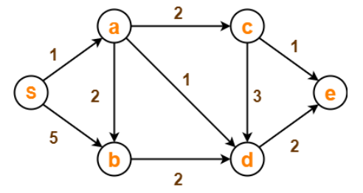
DIJKSTRA’S ALGORITHM
Node | Shortest Distance | Previous Node | Path
S | 0
a | ∞
b | ∞
c | ∞
d | ∞
e | ∞
if(dist ( i ) + cost ( i ,j ) < dist( j ) )
dist ( j ) = dist ( i ) + cost ( i ,j )
dist(j) = min(dist(j), dist(i)+cost(i,j))

Slide 16
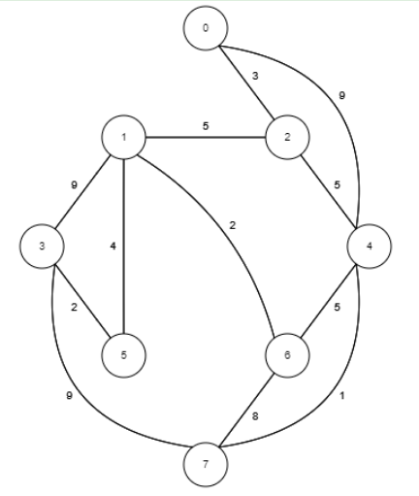
DIJKSTRA’S ALGORITHM
dist(j) = min( dist(j), dist(i)+cost(i, j) )
Node | Shortest Distance | Previous Node | Path
0 | 0
1 | ∞
2 | ∞
3 | ∞
4 | ∞
5 | ∞
6 | ∞
7 | ∞

Slide 17
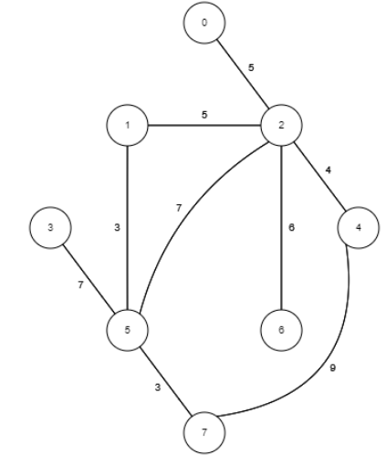
DIJKSTRA’S ALGORITHM
if(dist ( i ) + cost ( i ,j ) < dist( j ) )
dist ( j ) = dist ( i ) + cost ( i ,j )
dist(j) = min(dist(j), dist(i)+cost(i,j))
Node | Shortest Distance | Previous Node | Path
0 | 0
1 | ∞
2 | ∞
3 | ∞
4 | ∞
5 | ∞
6 | ∞
7 | ∞

Slide 18
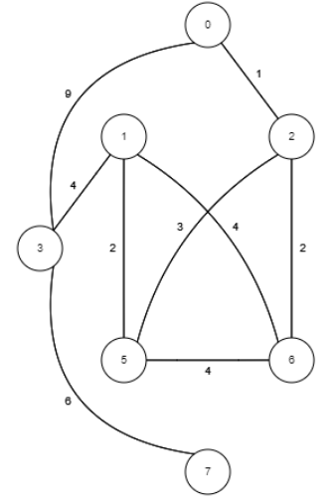
DIJKSTRA’S ALGORITHM
if(dist ( i ) + cost ( i ,j ) < dist( j ) )
dist ( j ) = dist ( i ) + cost ( i ,j )
dist(j) = min(dist(j), dist(i)+cost(i,j))
Node | Shortest Distance | Previous Node | Path
0 | 0
1 | ∞
2 | ∞
3 | ∞
4 | ∞
5 | ∞
6 | ∞
7 | ∞

Slide 19
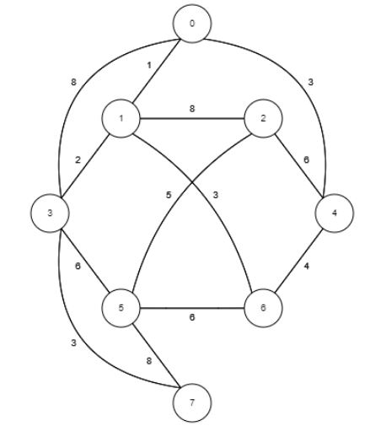
Node | Cost | Path
0 | 0
1 | 1 | 0 1
2 | 9 | 0 1 2
3 | 3 | 0 1 3
4 | 3 | 0 4
5 | 9 | 0 1 3 5
6 | 4 | 0 1 6
7 | 6 | 0 1 3 7

